Slide 1



Slide 2
Document
Parts
Graphics
Ribbons
Tools
Formatting
100
100
100
100
100
200
200
200
200
200
300
300
300
300
300
400
400
400
400
400
500
500
500
500
500

Slide 3
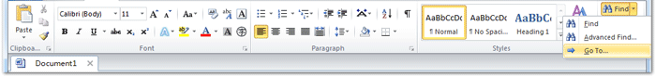
Answer 1-1
This ribbon shows the most used features of Microsoft Word.

Slide 4
Question 1-1
What is the Home Ribbon.

Slide 5
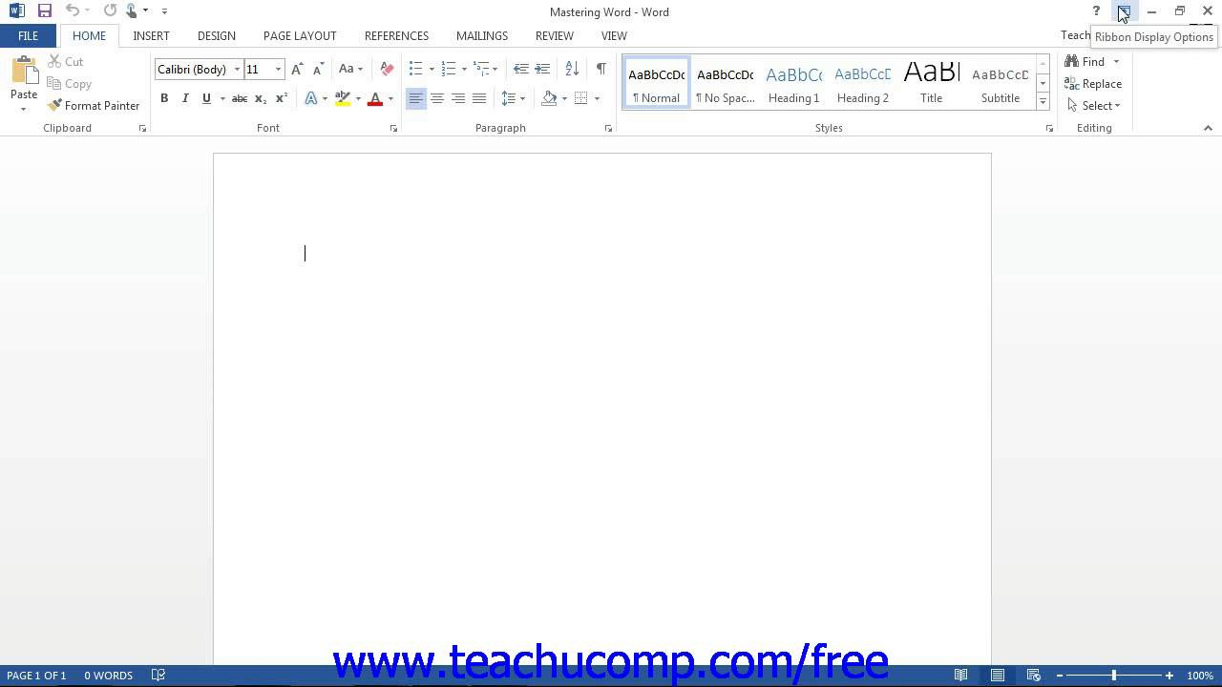
Answer 1-2
Shows the name of the document.

Slide 6
Question 1-2
What is the Title Bar

Slide 7
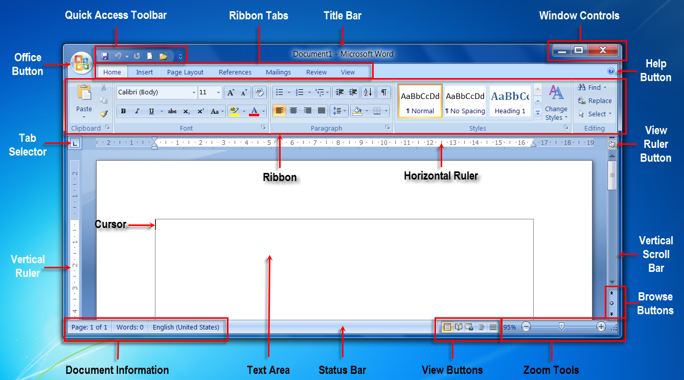
Answer 1-3
This bar shows the page numbers, word count, Language, View and Zoom.

Slide 8
Question 1-3
What is the Status Bar?

Slide 9

Answer 1-4
The name of this tool.

Slide 10
Question 1-4
What is the Show/Hide Button?

Slide 11

Answer 1-5
This toolbar can be customized by the user.

Slide 12
Question 1-5
What is the Quick Access Toolbar?

Slide 13
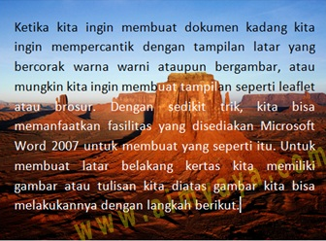
Answer 2-1
A Graphic Style used in Microsoft Word

Slide 14
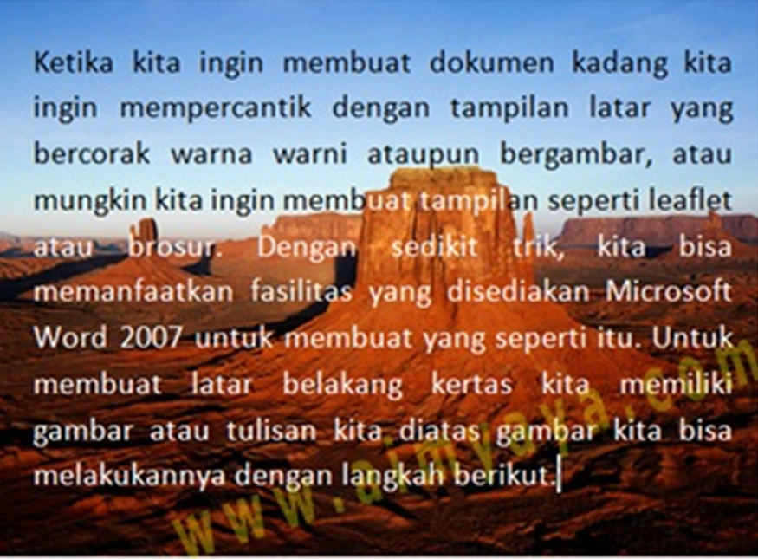
Question 2-1
What is Behind the Text?

Slide 15
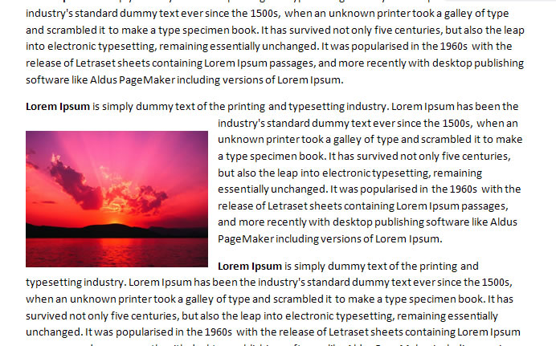
Answer 2-2
A Graphic Style used in Microsoft Word.

Slide 16
Question 2-2
What is square to text?

Slide 17
DAILY DOUBLE
DAILY DOUBLE

Slide 18
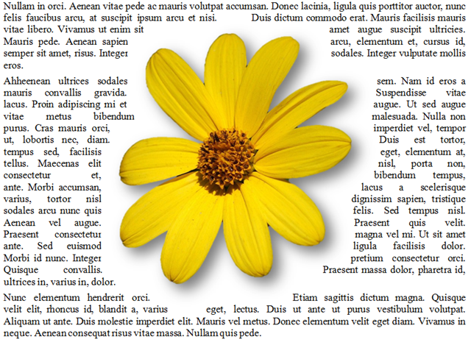
Answer 2-3
A Graphic Alignment Style used in Microsoft Word

Slide 19
Question 2-3
What is Tight with text?

Slide 20
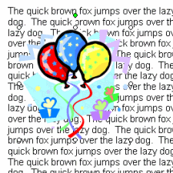
Answer 2-4
A graphic alignment style used in Microsoft Word.

Slide 21
Question 2-4
What is In front of Text?

Slide 22
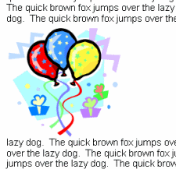
Answer 2-5
A Graphic Alignment Style used in Microsoft Word

Slide 23
Question 2-5
What is Top/Bottom Text Alignment?

Slide 24
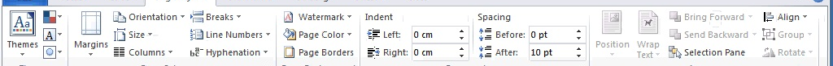
Answer 3-1
This Ribbon and Group is where the operator can change the Margin of a document.

Slide 25
Question 3-1
What is Page Layout/Page Set Up?

Slide 26
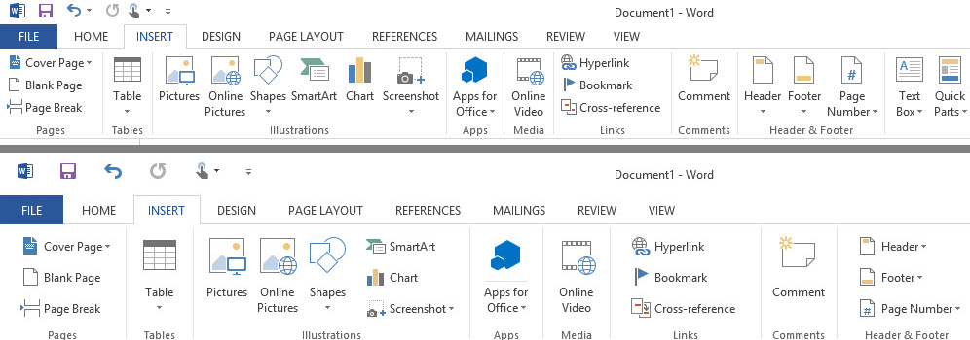
Answer 3-2
This Ribbon is used to place a
textbox into a document.

Slide 27
Question 3-2
What is the Insert Ribbon?

Slide 28
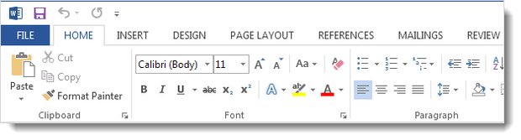
Answer 3-3
The main Ribbon in Microsoft Word, where many of the most used functions are found.

Slide 29
Question 3-3
What is the Home Ribbon?

Slide 30

Answer 3-4
The Ribbon used to change the page view, show the ruler or show multiple pages on the screen.

Slide 31
Question 3-4
What is the View Ribbon?

Slide 32
Answer 3-5
The Ribbon used to add a header or footer to a document.

Slide 33
Question 3-5
What is the Insert Ribbon?

Slide 34
Answer 4-1
These can be used to perfectly align multiple columns of text without using a table and can be set at any interval by the user.

Slide 35
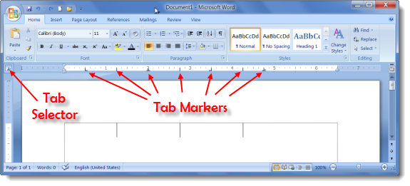
Question 4-1
What are Tabs?

Slide 36
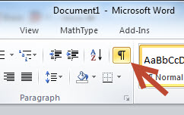
Answer 4-2
This button is used to show Tabs, Spaces, and Paragraphs in Microsoft Word

Slide 37
Question 4-2
What is the Show/Hide Button?

Slide 38
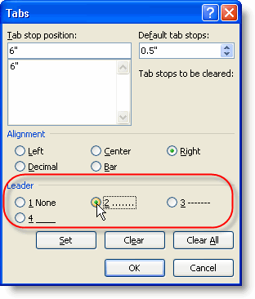
Answer 4-3
The path used to set tabs with dot leaders. (Ribbon/Group).

Slide 39
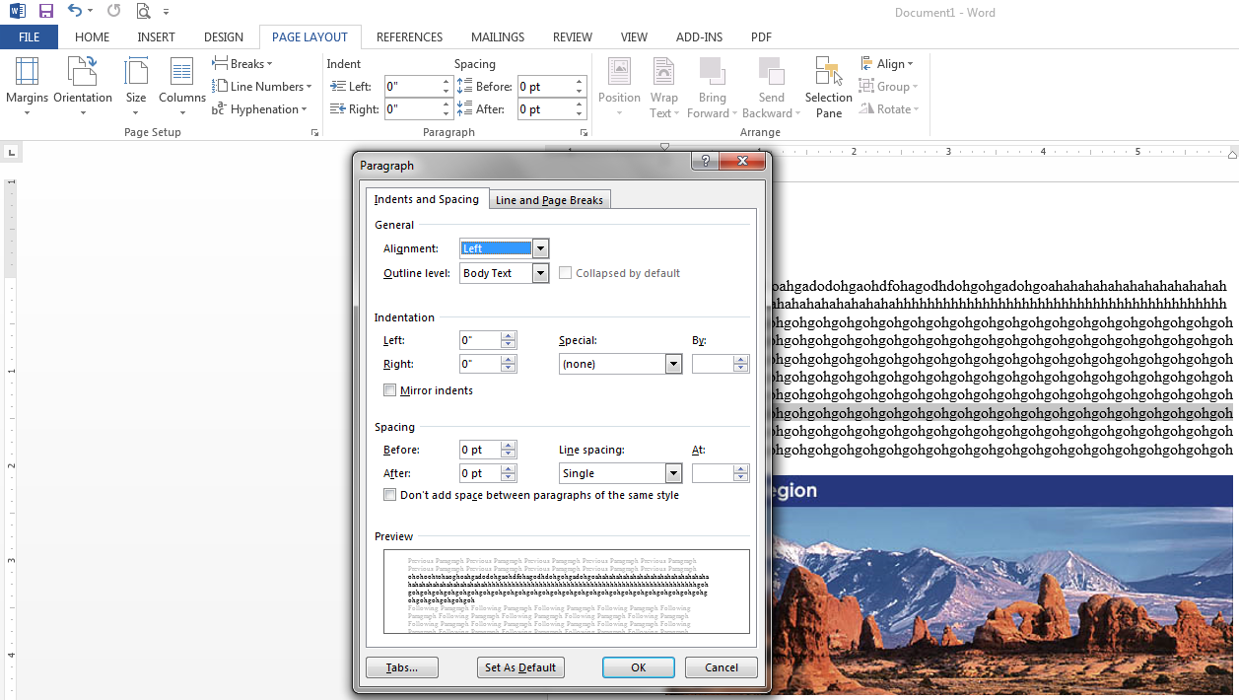
Question 4-3
What is Page Layout, Paragraph Group?

Slide 40
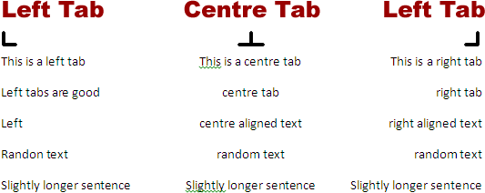
Answer 4-4
This tab can be set using tab selector button and the ruler.

Slide 41
Question 4-4
What is Left Tab?

Slide 42
Answer 4-5
This feature might be used in a Table of Contents or on a menu, and must be set using the dialogue box rather than the ruler.

Slide 43
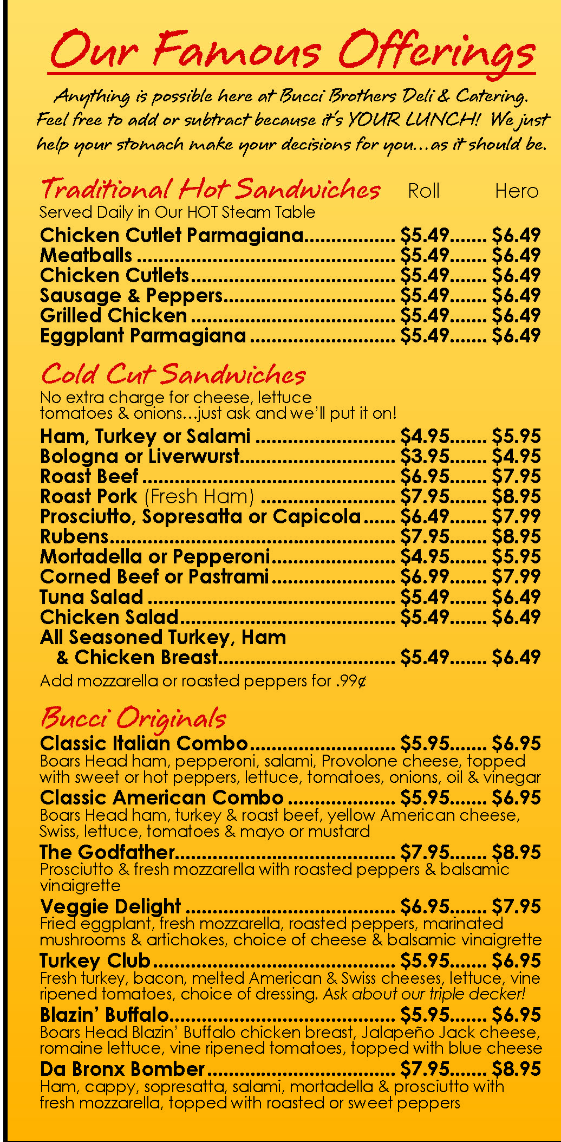
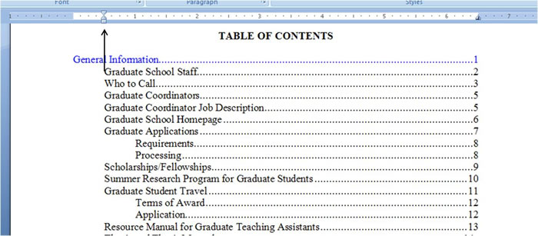
Question 4-5
What is a Dot Leader?

Slide 44
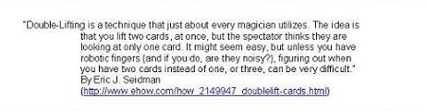
Answer 5-1
This is an example of a type of paragraph indentation in Microsoft Word.

Slide 45
Question 5-1
What is a Hanging Indent?

Slide 46
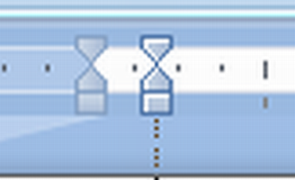
Answer 5-2
Using this slider showing the double arrow will change this in a Microsoft Word Document.

Slide 47
Question 5-2
What is the Left Margin?

Slide 48
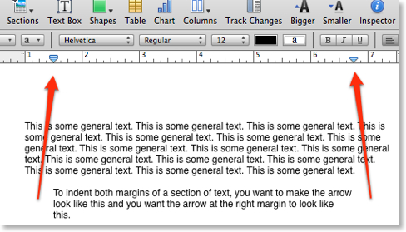
Answer 5-3
This is the Symbol for what type of Indent and can be made using the ruler.

Slide 49
Question 5-3
What is a Hanging Indent?

Slide 50

Answer 5-4
This is a type of text alignment in Microsoft Word.

Slide 51
Question 5-4
What is Centered

Slide 52
Answer 5-5
The white space around the edge of a document.

Slide 53
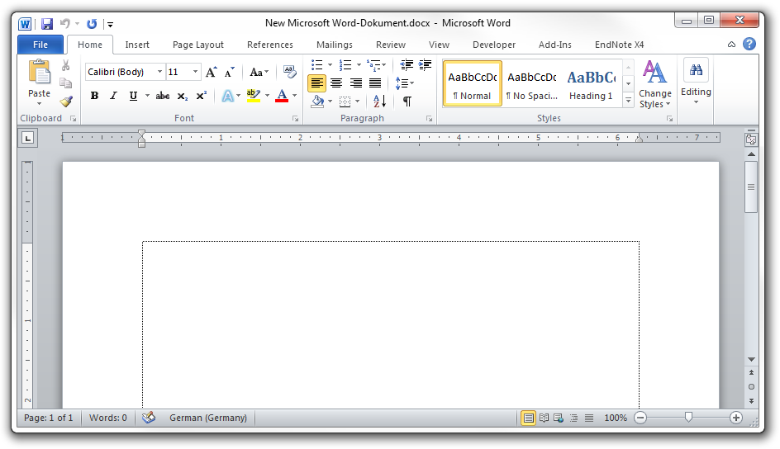
Question 5-5
What is a margin?

Slide 54
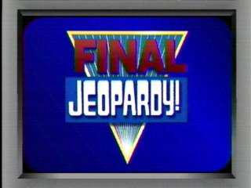

Slide 55
Final Jeopardy Answer
This feature allows a user copy text formatting multiple times.

Slide 57
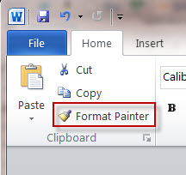
Final Jeopardy Question
What is FORMAT PAINTER?

